Slide 1
MAINTAINING GOOD PRACTICE & BEHAVIOUR
RECRUITMENT OF COACHES
Coaches working with young players are required to be suitable for their chosen role(s), and should be appropriately trained, qualified and supported when fulfilling such roles. Coaches are required (under legislation and Rule) to:
● Undertake agreed Garda Vetting
● Attend Gaelic Games child safeguarding training
● Possess a coaching qualification.
COACHES SHOULD MAINTAIN A CHILD CENTRED APPROACH
● Respect the rights, dignity and worth of every person.
● Treat each person equally regardless of ability, ethnic origin, religion etc.
● Be positive during coaching sessions & games
● Recognise the development needs and capacity of all players, regardless of their ability, by emphasisingparticipation for all while avoiding excessive training and competition.
● Recognise that skills development and personal satisfaction should have priority over competition when working with underage players
● Do not equate losing with failure and try not develop a preoccupation with medals and trophies. The level of improvement made by underage players is the best indicator that you are doing a great job.

Slide 2
CONDUCT OF COACHES WHEN WORKING WITH YOUNG PEOPLE
● Develop an appropriate working relationship with children based on mutual trust and respect.
● Challenge Bullying in any form whether physical or emotional. Bullying is not acceptable behaviour be it from a young person, coach, parent/guardian, spectator or match official.
● Do not shout at or lecture players or reprimand/ridicule them when they make a mistake. Children learn best through trial and error. Children and young people should not be afraid to risk error so as to learn.
● Avoid incidents of horse play or role play or telling jokes etc. that could be misinterpreted.
AVOID COMPROMISING YOUR ROLE AS A COACH
● Avoid taking coaching sessions on your own.
● Any delivery of one to one coaching must be within a group setting.
● Avoid unnecessary physical contact with an underage player.

Slide 3
BEST PRACTICE
● Be accompanied by at least one other adult at coaching sessions, games and in underage team dressing rooms.
● Set realistic – stretching but achievable – performance goals for your players and teams
● Rotate the team captaincy and the method used for selecting teams so that the same children are not always selected to the exclusion of others.
● Afford meaningful playing time to young players so as to assist in the development of their playing skills, within their own age groups.
● Keep a record of any injuries and actions subsequently taken. Ensure that another official referee/team mentor is present when a player is being attended to and can corroborate the relevant details.
● Do not encourage or permit players to play while injured.
● Inform parents/guardians if their child has been injured or becomes unwell at games and training as soon as is practical.
● If it is necessary to transport a child/young person in your car, ensure that they are seated in a rear seat with seat belts securely fastened and that all drivers are adequately insured.
● With the exception of their own child a coach should not transport a child alone, except in emergency or exceptional circumstances.
● Should you be aware of or have concerns regarding the possible abuse of a child you should, without delay, report this to the the relevant authority or your DLP.

Slide 4
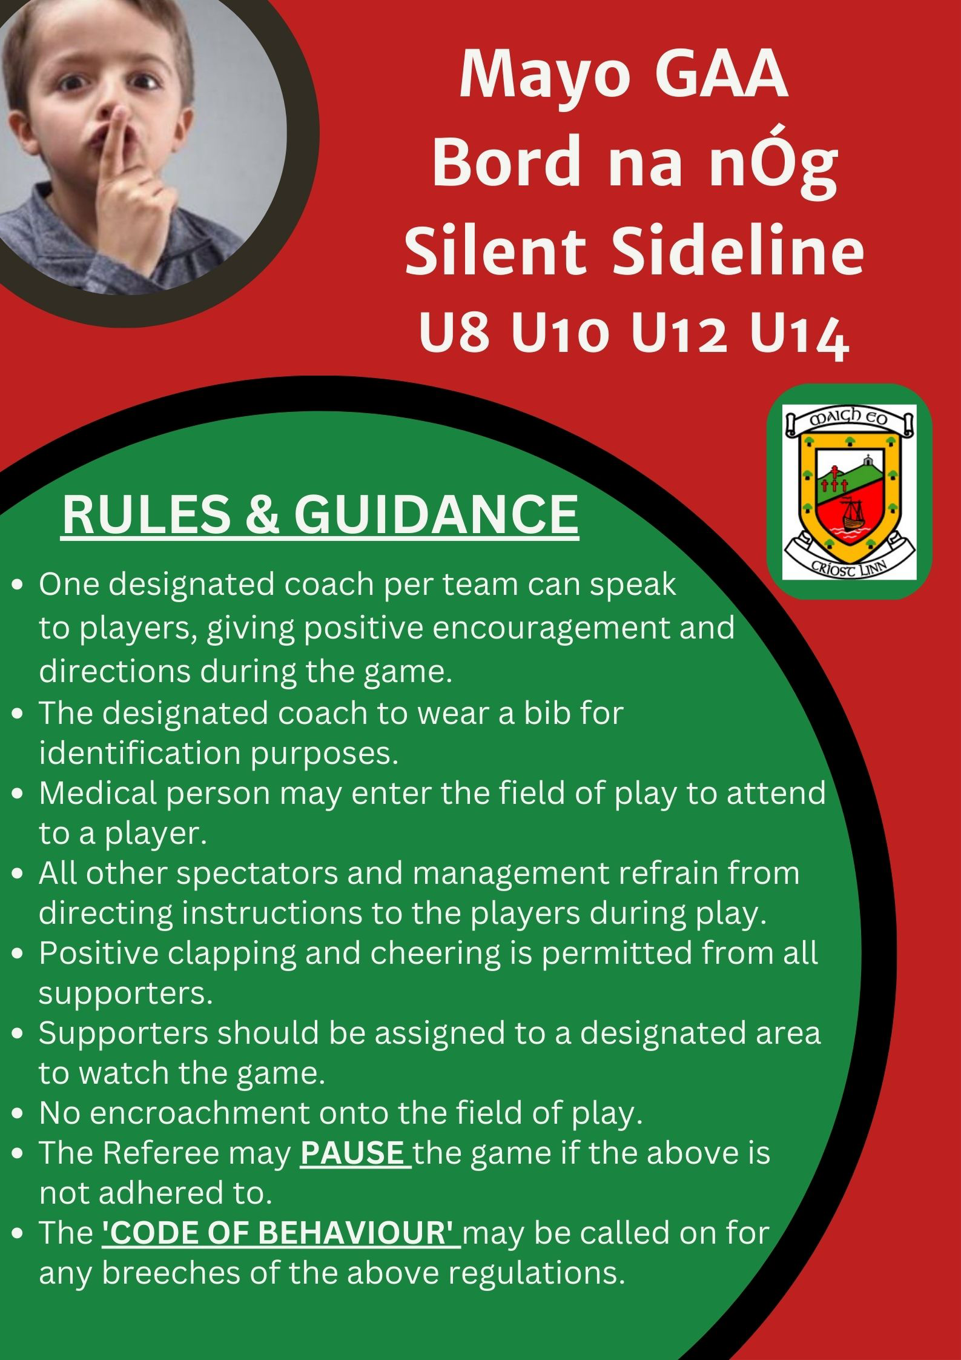

Slide 5
Rules and Regulations 2024 Bord na nÓg
Give Respect Get Respect
All Clubs are expected to adhere to the GAA Respect initiative, "Give Respect - Get Respect"
This programme seeks to ensure that Gaelic Games are promoted and played in a positive, fair and enjoyable manner where players, coaches, spectators and referees, "Give Respect - Get Respect". From each other.
Referees: To be welcomed to the GAA Club.
Before the Game: Players to shake hands with their opposing player
After the Game: Players to line up behind their manager after the game to shake hands with the referee, opposing players and coaches
Always respect the match officials' officials and encourage children to do likewise,

Slide 6
Go Games National policy.
Go Games are small-sided versions of Hurling and Gaelic Football which have been devised for children up to and including 12 years of age.
(A) All participants play as much as possible for as long as possible. (B) Participant needs are catered for, where possible, on the basis of two-year age cohorts; i.e., Under-8, Under-10 & Under 12 in a manner consistent with the ethos of Go Games.
(C) Activities are structured in a manner which optimises the level of fun, friendship, fair play and achievement derived by participants.
(D) Participants train and play in a safe, supportive and stimulating environment where they are encouraged to risk error, to learn and to derive maximum enjoyment from their involvement.
(E) Players master the basic skills of Hurling and Gaelic Football and experience the sense of accomplishment, which derives from acquiring playing proficiency on the left- and right-hand sides of the body.
(F) Everybody involved in Go Games, whether as players, parents/guardians, spectators, mentors, teachers, officials, etc., should adhere to the key underpinning principles and give expression to the GAA ‘Give Respect, Get Respect’ initiative.

Slide 7
Go Games Regulations
(A) Go Games are subject to general rules of the Association.
(B) Teams shall be a maximum of 13 a side at U12
(C) Participants may play up one age grade i.e.
Under-11 may play at Under-12
(D) No provision is made to publish scores, to play on a knock-out basis nor to include semifinals, finals etc. Mayo Bord na nÒg will remove all results and award a win as one point to no score.
(E) No provision is made to present trophies, cups etc. Mayo Bord na nÒg will award all the team that tops the league a set of medals, if this is more than one team, all will get medals. A maximum of 24 medals per team.
(F) Code (11.7) Games in the Under 12 and Under 13 age grades shall be organised on a league basis, as approved by Central Council.

Slide 8
(E) The first named team has home advantage.
(F) Clubs will be fined for games that do not start on time, in line with fine imposed for county senior league.
(G) Only the official team parties are allowed inside boundary fences i.e., maximum of twenty-five players and five officials. Fine of €75 for breaches.
Gum Shields Rule, in all football Games and Football Practice Sessions it shall be mandatory for, and the responsibility of, each individual player to use a mouth guard.
Rule 6 - Dissent (6.2) to fail to comply with a Referee’s instruction to use a mouth guard. Penalty- Caution the offender, order off if the offender persists.

Slide 9
Team Sheets
(A) 2.3(i)Before all official games, the referee shall be given a list of players, in duplicate and in Irish. This is including Under 12 and up. Code (15.2) (C)
(i) Failure to provide a list of players as specified in Rule, Penalty is, On an inquiry by the committee-in-charge - Forfeiture of game, without award to the opposing team, or fine, depending on the circumstances.
(D) Teams are required to use Foireann team lists. Failure to produce same shall result in €100 fine for the team. All Team Sheets Must be signed by your secretary.

Slide 10
Postponements
(A) Postponements will not be granted, except by mutual agreement between the two clubs involved.
(B) The agreed new date must be within 2 weeks of the original fixture. The Rúnaí must be notified in writing before the date of the original fixture as to when the refixture will take place. No postponements will be allowed for the final round of all leagues and all previous rounds must be completed before the final round.
(C) If the Rúnaí does not have this information, the game will be null and void with the loss of points and a fine of €250 will be imposed on both clubs.
(E) Postponements will only be granted when the Rúnaí is notified in written format via email, and the Rúnaí has responded to grant the postponement.
(F) Any correspondence to Bord na nÓg relating to a fixture must include the Bord na nÓg Rúnaí and the secretary of both clubs involved in the fixture.
(G) It is the responsibility of the club seeking postponement to notify the referee; however, best practice is recommended where both clubs contact the referee to confirm.
(H) Any games re fixed by the county Bord na nÓg/Divisional Board cannot be postponed by mutual agreement.
(I) Any un-played rounds will be declared null and void.
(J) A fine of €250 per game will be imposed in respect of each unfulfilled Fixture.

Slide 11
Pitch: Can play two games on one pitch
Goals: Temporary Goals (15'w X 6'h)
Length: 13m line to 13m line
Width: Sideline to middle of pitch
Optional: Small square
Team size: Max 13 a side
Football: Size 4 or smart touch
Kickout: Keeper from hand, all others from ground
Duration: 52 minutes (4 x 13 mins)
Player: Every player must play at least one full quarter
Substitutes: Unlimited
Play: Two plays (1 hop & 1 solo or 2 solo)
Penalties: No
Free/Sideline: Normal Rules (opponent at least 10 meter away)

Slide 12
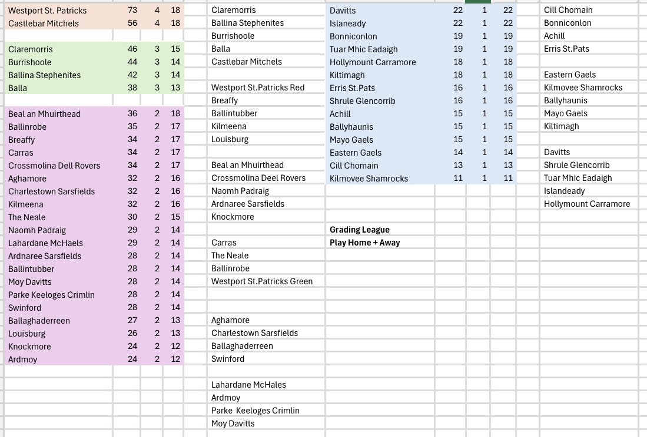

Slide 13
4 Team Groups
Round 1 April 10th
Round 2 April 17th
Round 3 April 24th
Round 3 May 8th
Round 4 May 15th
Round 5 May 29th
Round 6 June 5th
All Teams Get 6 Games
5 Team Groups
Round 1 April 10th
Round 2 April 17th
Round 3 April 24th
Round 4 May 1st
Round 5 May 8th
Round 6 May 15th
Round 7 May 22nd
Round 8 May 29th
Round 9 June 5th
Round 10 June 12th
All Teams Get 8 Games

